Slide 1
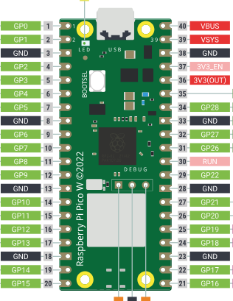
Heart D
Heart C
Heart GND
OLD
Pressure V + Temp V + Heart V
Pressure Signal
Pressure GND
Temp GND
Temp signal

Slide 2
NEW
Heart GND
Pressure V + Temp V + Heart V + Speaker V + LCD V +
Heart D + LCD SDA
Heart C + LCD SCL
Pressure Signal
Speaker GND + Pressure GND
Temp GND
LCD GND
Speaker Signal
Temp signal

Slide 3
MOTOR
Heart GND
Pressure V + Temp V + Heart V + Speaker V +
LCD V + P1 V + P2 V + Servo V + Humidity V
Heart D + LCD SDA
Heart C + LCD SCL
Pressure Signal
Servo GND
P1 Signal
P2 Signal
Speaker GND + Pressure GND
Temp GND
P1 GND + P2 GND + Humidity GND
LCD GND
Humidity Signal
Servo Signal
Speaker Signal
Temp signal

Slide 4
FULL
LCD
SDA
SCL
Pressure
Heart
Pot 1
Pot 2
+3V3 Battery
Humid
Servo
Servo
Temp

Slide 5
Solar Panel
Solar Board
Battery
Switch
SOLAR
LDR
LDR
Resistor
Resistor
Servo

Slide 6
